Slide 1
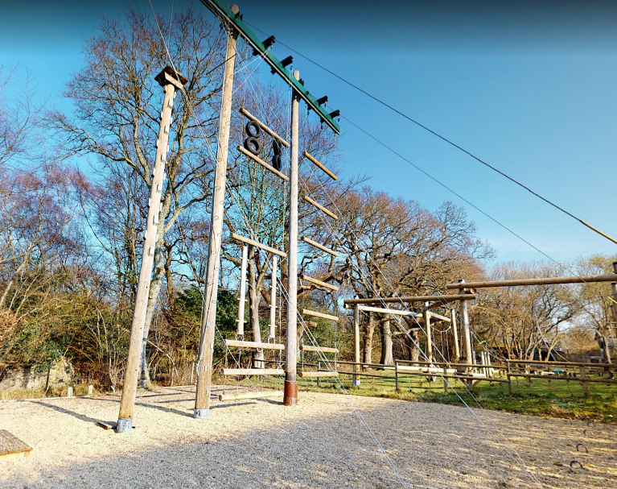
Year 5
Tile Barn residential
Insert
Tile Barn pic
Monday 22nd April – Wednesday 24th April 2024

Slide 2
Dates and Times
Monday April 22nd to Wednesday 24th April
We depart at approximately 11am – children to arrive at school at the usual time of 8:30-8:40am (in non- uniform)
We will eat our packed lunch at Tile Barn before the first activity begins.
Pick up will be close to the end of the school day on Wednesday from the School.
Final times will be communicated on Wednesday PM
Please ensure you sign your child out.

Slide 3
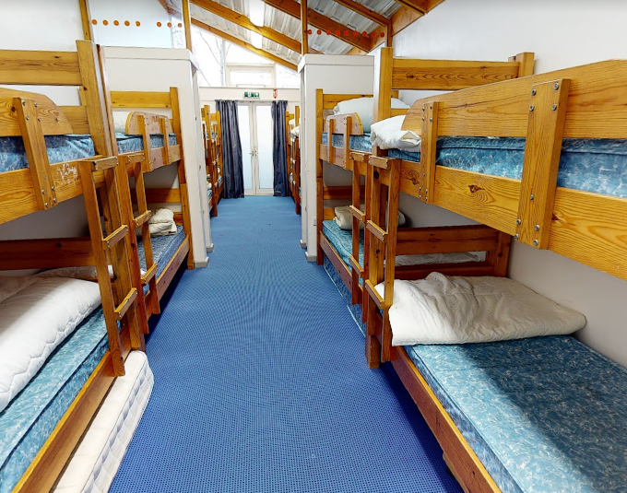
Tile Barn Accommodation
Accommodation is in 2 dorm rooms that sleep up to 16 children each in the main building and 20 pods that sleep up to 4 children in each pod.
Children will be allocated rooms based on their
friendship selections (they will be asked).
Toilets are located in the main building and in an additional toilet and shower block.
Remember you must to
bring a sleeping bag and pillow.
Don’t forget a torch!

Slide 4
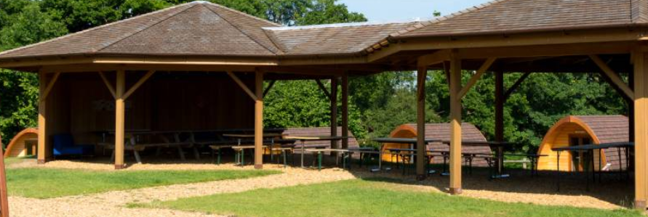
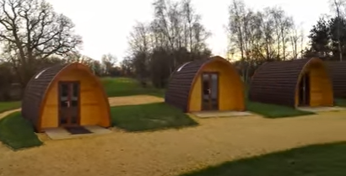
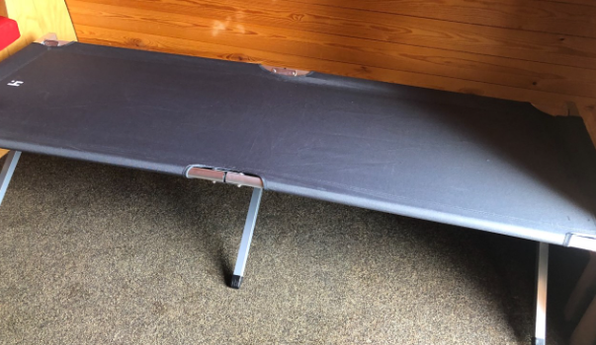
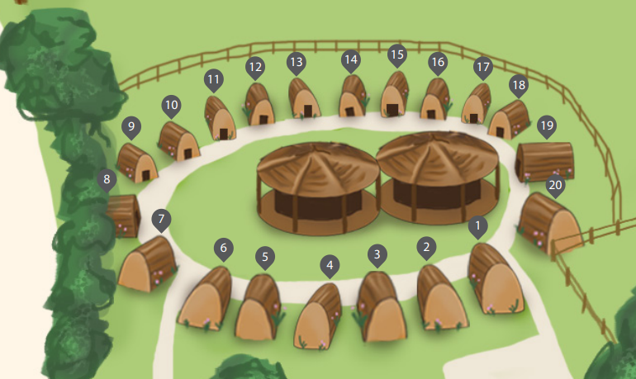
Accommodation

Slide 5
Accommodation
https://www.youtube.com/watch?v=Ej4YEbhEnsk
https://www.hants.gov.uk/thingstodo/outdoorcentres/education/our-centres/tilebarn

Slide 6
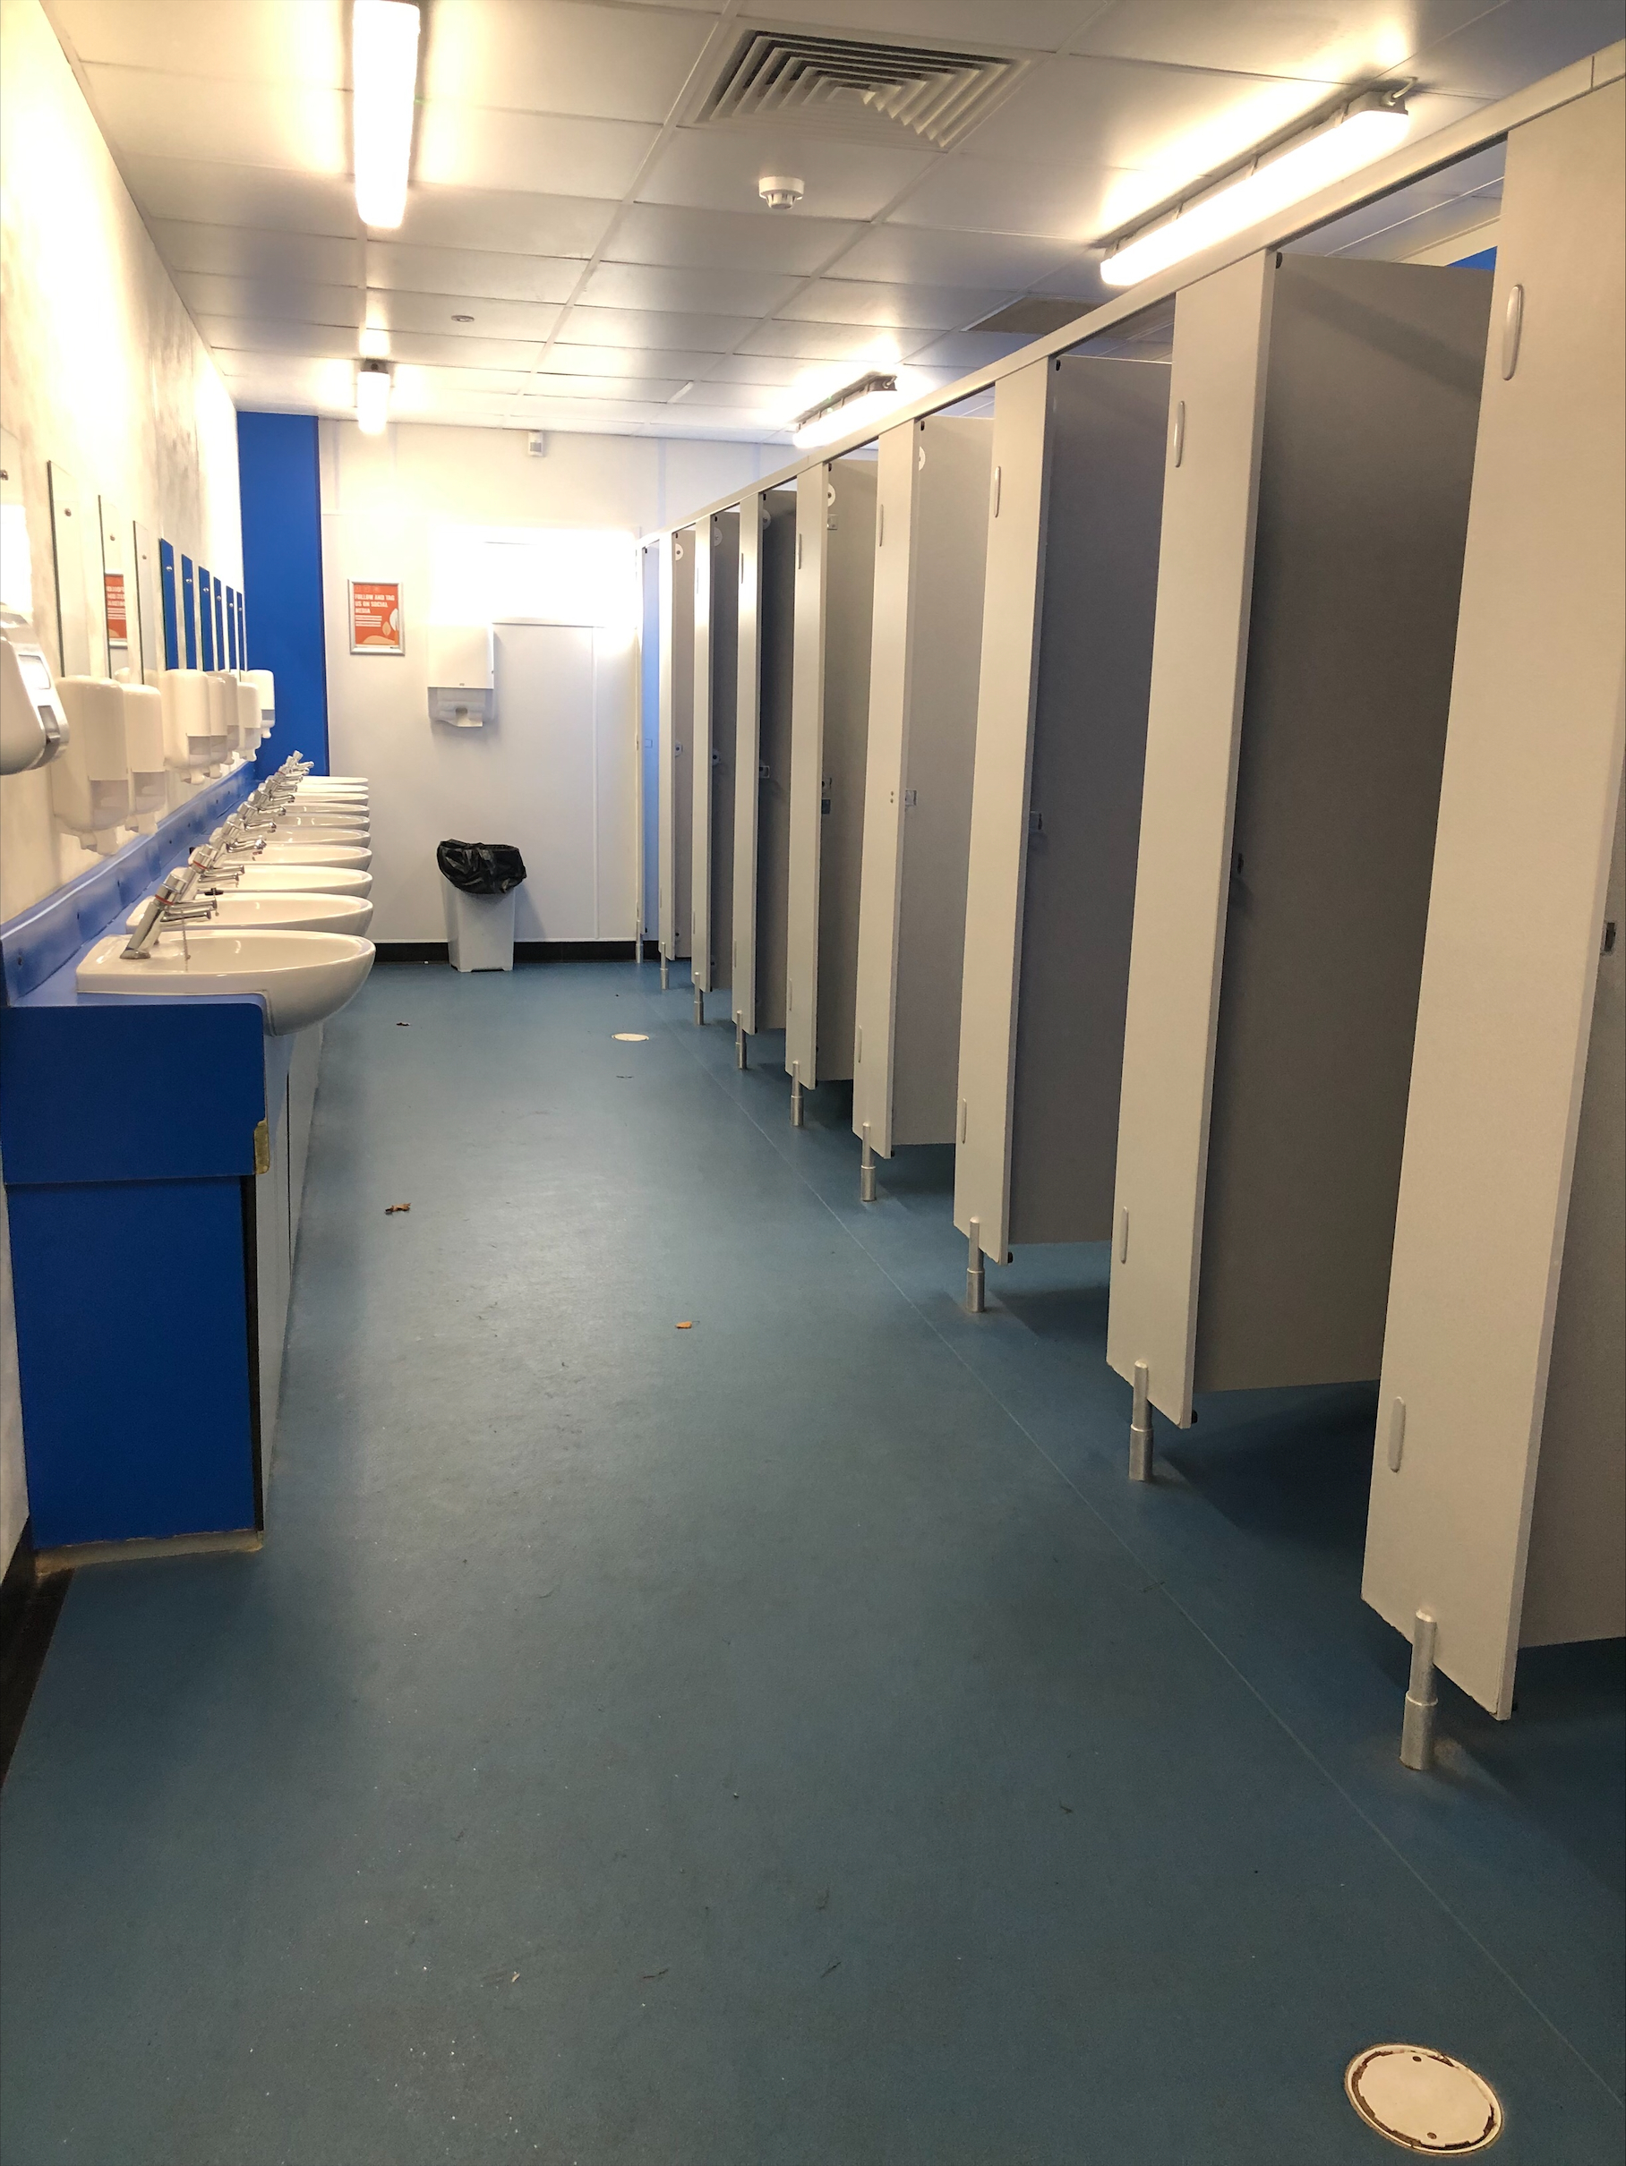
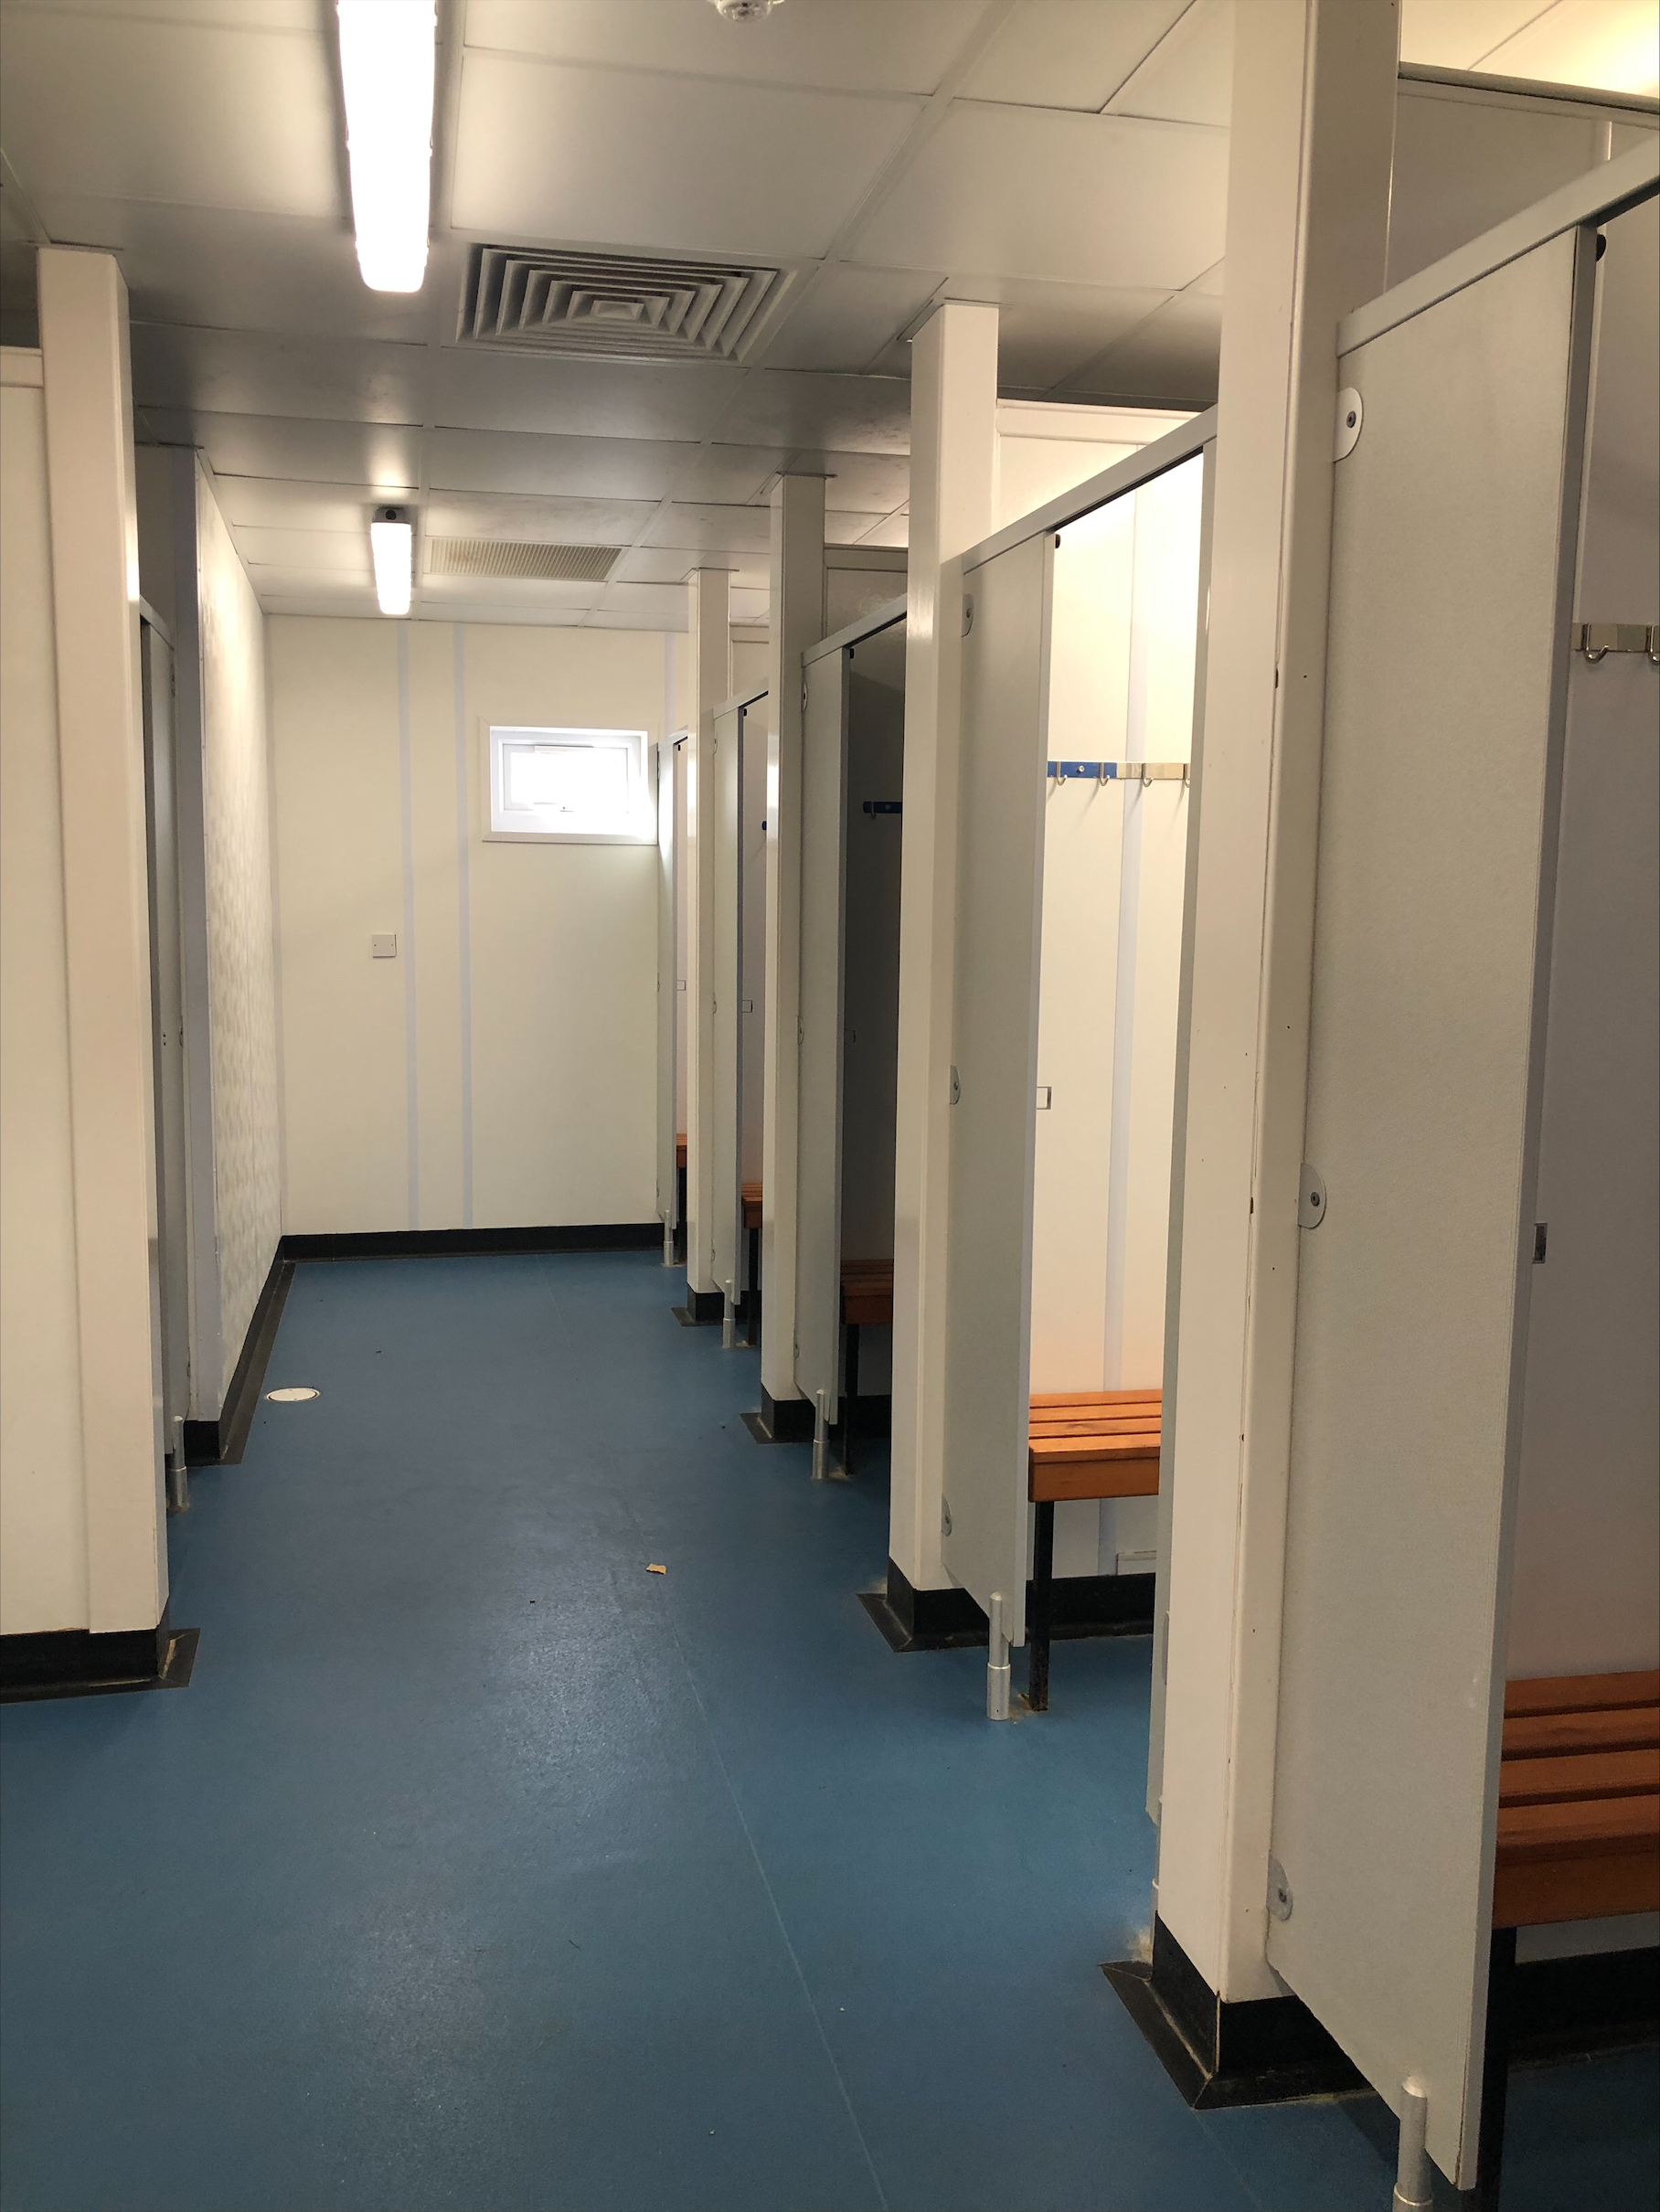

Slide 7
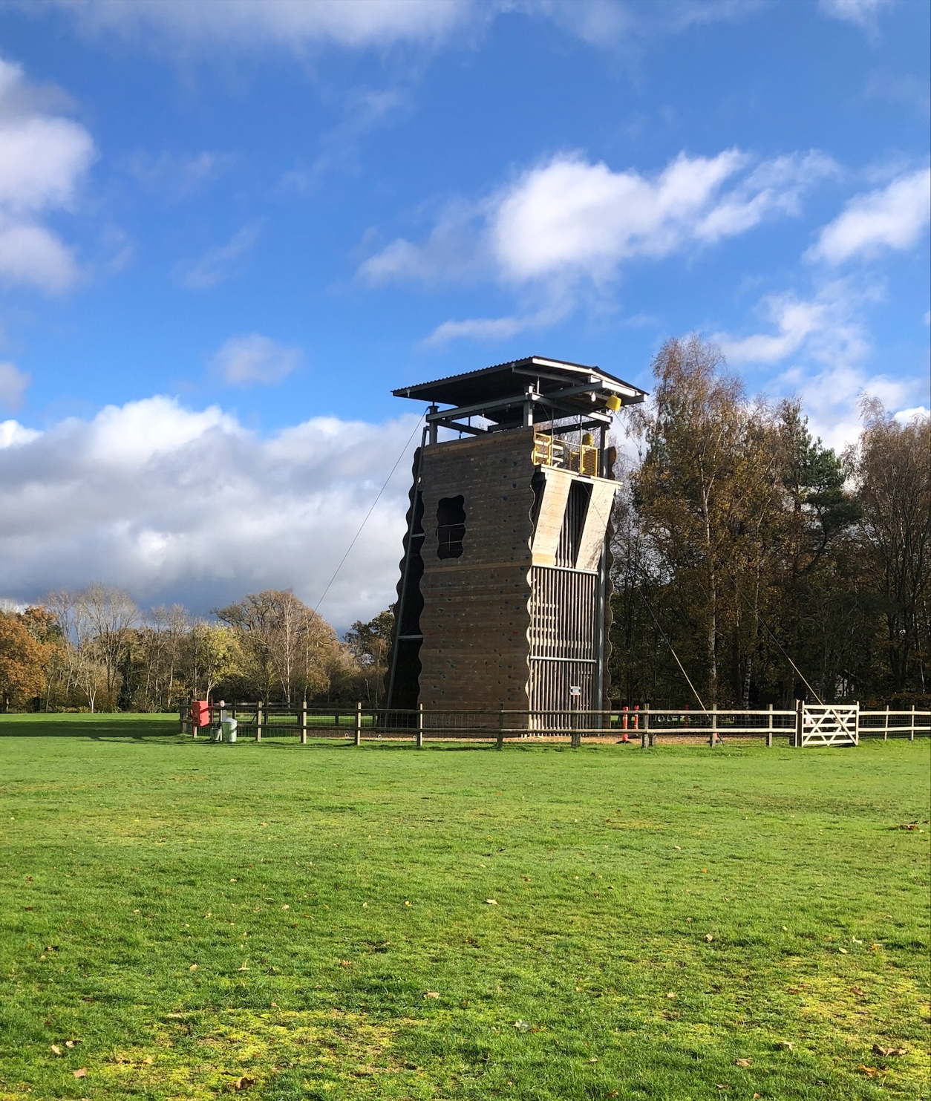
Activities
We shall be participating in 2 activities each morning and 2 more activities after lunch. Plus two evening activities run by school staff. Children will be organised into 6 daytime activity groups Possible Activity Programme: Rock climbing, Fire lighting, Water rockets, Archery, Orienteering, Low Ropes and problem solving.

Slide 10
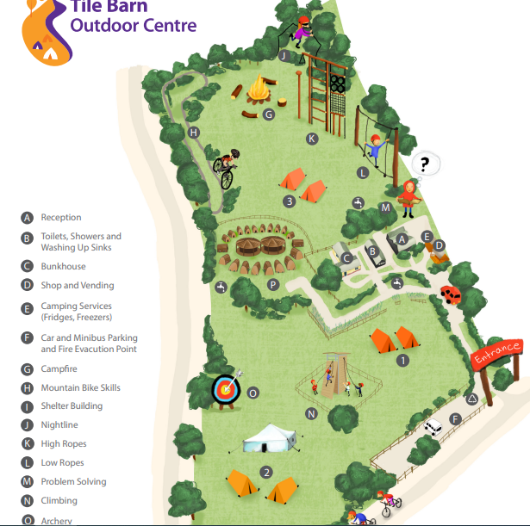
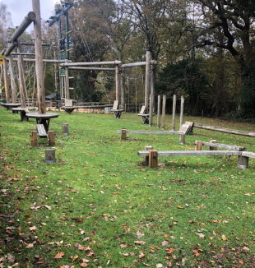
https://www.youtube.com/watch?v=hT1H8TgLeK8 – Shows activities

Slide 11
Catering
The New Forest Catering Company at Tile Barn provides
3 nutritious and well-balanced meals a day.
Children must bring a reusable water bottle, they will need
to take this with them to every activity. There are plenty
of places for the children to refill their bottles.
Tile Barn caterers are able to deal with most dietary
requirements and we will ensure they are informed of those
we are aware of.

Slide 12
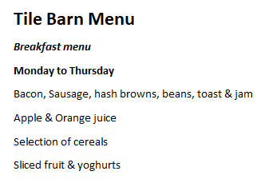
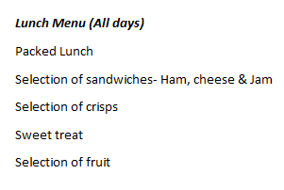
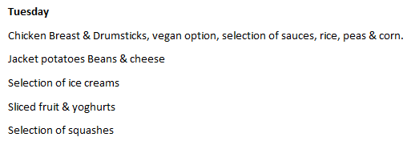
Sample Menu

Slide 13
What to pack
Kit List
Remember to check the kit list!
Please make sure that all personal belongings are clearly labelled with your child’s name.
Please put your child’s spending money into a sealed envelope clearly labelled with your child’s name and ‘Spending Money’, and hand it to their class teacher on the Monday morning.
Medication – medication administration permission forms should be completed and handed to the class teacher with the medication on the Monday morning.

Slide 14
Valuables
Please do not allow your child to bring any valuables including mobile phones or electronic toys.

Slide 15
Medicines
Medicines should be stored in a clearly labelled plastic container (name and class) - with written instructions ON THE MEDICATION ADMINISTRATION/PERMISSION FORM PROVIDED as to how they should be taken.
Hand these to your child’s class teacher on Monday morning, on the playground.
If you wish your child to have a travel sickness tablet for the journeys to and from Tile Barn on Monday and Wednesday, then please include these – remember to complete a medication administration and permission form to allow us to administer these.

Slide 16
Emergency Contact Numbers
In the event of your needing to contact us in an emergency we can be reached on the following numbers.
School – 01722 327218
School Mobile – 07562 342792
TILE barn - 01590 623160
Please ensure we have your correct contact details in case we need to make contact with you. If any of your contact numbers change before our departure you must inform us.

